Slide 1

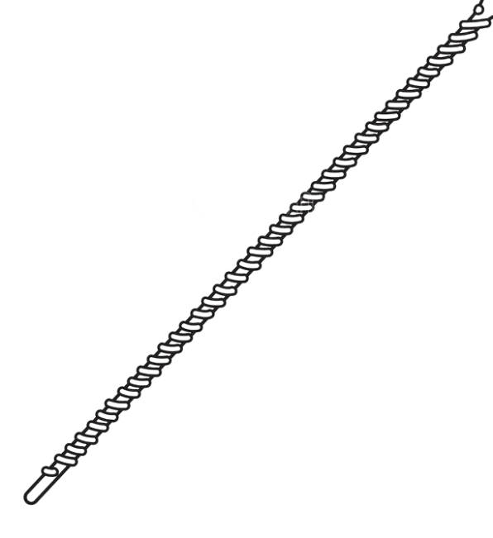

Stepper Motor
Research Syringe Pump
Information Pump
Flow Rate
Volume

Slide 2

MACHINE PRINCIPLE
Syringe
Plunger
Linear slider
Flexible plastic tubing
Stepper Motor
Distilled water
Belt
Microfluidic device
Syringe holder
Stepper Motor
Research Syringe Pump
Driver Stepper Motor
Information Pump
Volume
Flow Rate

